Slide 1

Capstone Project2
HEART DISEASE DETECTION USING CLASSIFICATION ALGORITHMS
Team Members
T120100204: DINESH S
T120100205: SRUJAN S D
T120100206: SUDARSHAN
T120100207: DINESH G

Slide 2
Table of Contents
Problem Statement
Overview of the Project
Data generation & Loading
Data Exploration & Understanding
Exploratory Data Analysis
Data Preprocessing & Feature Engineering
Model Building & Training
Model Evaluation & Performance Analysis
Stream API Deployment
Conclusion

Slide 3
Problem Statement
Heart disease is one of the leading causes of death worldwide. Early and accurate detection through diagnostic screening can significantly improve patient survival rates and reduce healthcare costs.
This project aims to build machine learning models that predict the presence of heart disease based on patients’ demographic, clinical, and diagnostic test data, enabling healthcare professionals to make timely and informed decisions.

Slide 4
Overview of the Project
Objective:
Develop a machine learning model to predict heart disease risk and provide insights for early diagnosis and prevention.
Approach:
Patient data was collected from publicly available medical datasets representing real-world health conditions.
Exploratory Data Analysis (EDA) was conducted to uncover patterns, correlations, and influential health factors.
Features were cleaned, encoded, and scaled to improve model interpretability and accuracy.
Multiple machine learning algorithms — Decision Tree, Random Forest, Logistic Regression, and SVM — were trained and compared.
The Random Forest model achieved the best performance, identifying key predictors such as chest pain type, ST depression, and max heart rate.
Finally, the model was deployed using Flask API, Streamlit interface, and Docker for real-time prediction and accessibility.

Slide 5
Data generation & Loading
Dataset Source: The project uses the heart_disease_dataset
Initial Data Loading: The dataset was loaded using the Pandas library in Python :
df = pd.read_csv("heart_disease_dataset.csv").
Dataset Dimensions:
The dataset contains 400 records (rows).
It comprises 14 columns: 13 predictive features and 1 target variable.
Target Variable: The variable to be predicted is heart_disease, which is a binary classification (0 = No Heart Disease, 1 = Heart Disease).

Slide 6
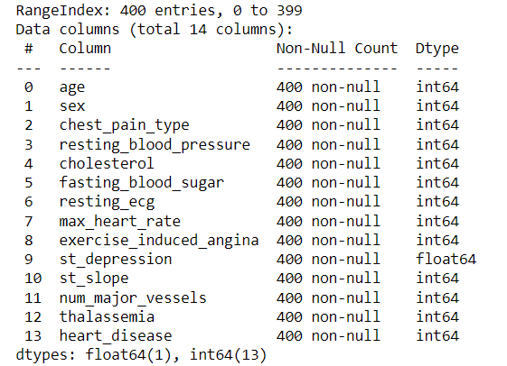
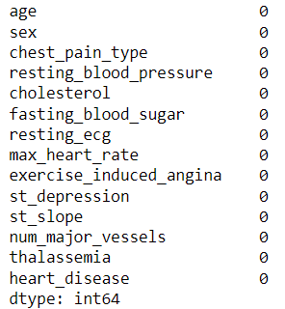
Data Exploration & Understanding
Data Structure Confirmation:
Verified the dataset shape: 400 rows and 14 columns (13 features + 1 target).
Data Type Review:
Inspected column data types using “df.info()”.
Noted that most features are integers (int64) and floating-point number (float64)..
Checked the entire data Descriptions using “df.describe()”
Luckily We don’t have any missing Values

Slide 7
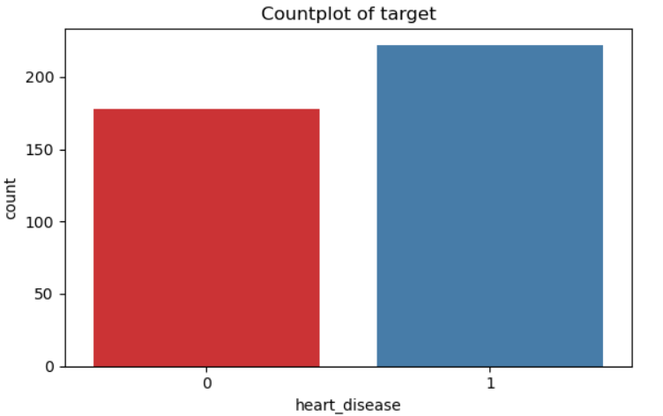

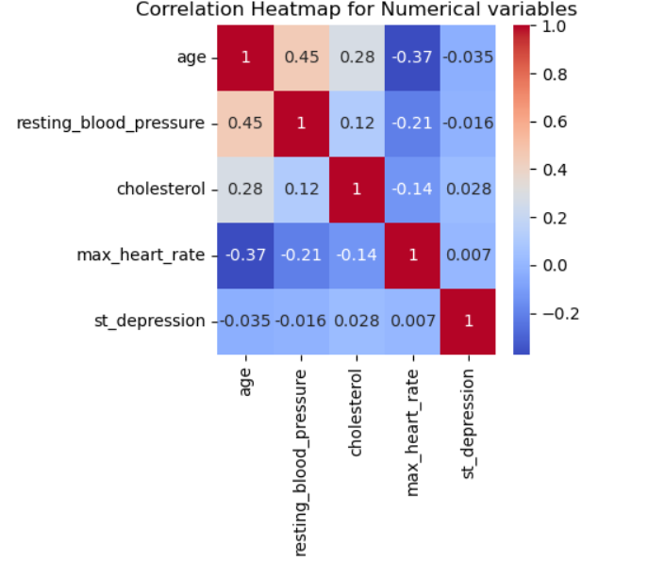
Exploratory Data Analysis
Checked dataset structure, missing values, and feature types.
Identified categorical and numerical features.
Target (heart_disease) showed balanced class distribution.
Visualized variable distributions using histograms and countplots.
Correlation heatmap revealed key relationships — chest_pain_type, ST depression, and max_heart_rate strongly linked to heart disease.
Insights from EDA guided feature selection and preprocessing for model training.

Slide 8
Model Building & Training
Algorithm Selection: We selected and compared four distinct classification algorithms to achieve the project objective:
Logistic Regression : A foundational linear model, highly interpretable.
Support Vector Machine (SVM): Effective in high-dimensional spaces, leveraging the kernel trick.
Decision Tree Classifier : A non-linear model, easy to understand.
Random Forest : An ensemble method (multiple decision trees) for improved accuracy and stability.
Training Data Input: Each model was trained using the 80% training dataset (X_train and y_train) that was prepared during the preprocessing phase.
Model Fitting: The fit method was applied to each model instance, allowing the algorithm to learn the relationship between the 13 features and the target variable heart_disease from the training data.
Prediction Generation: After training, each model generated predictions on the 20% testing dataset (X_test) to evaluate its performance on unseen data.

Slide 9
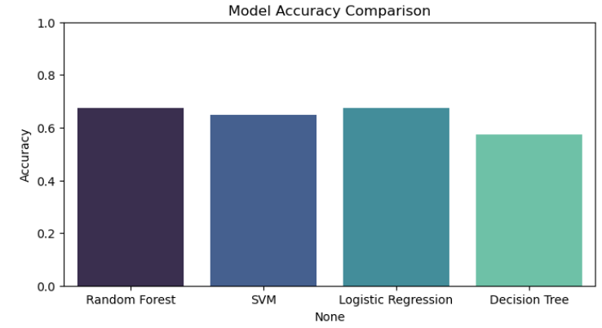
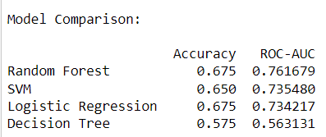
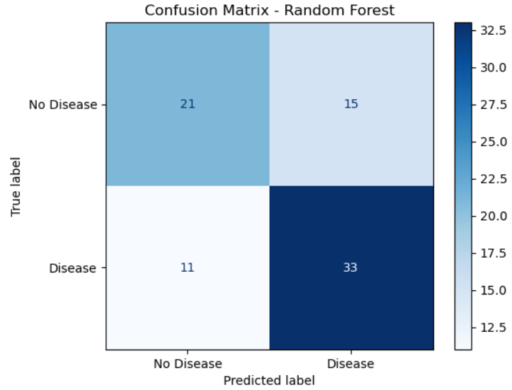
Model Evaluation & Performance Analysis

Slide 10
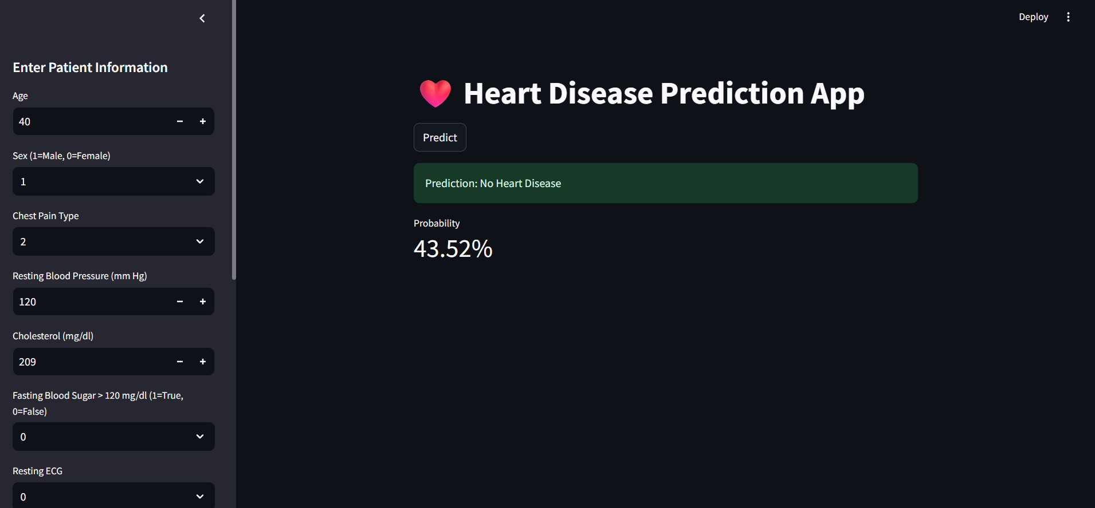
Stream API Deployment
Flask-based Inference Endpoint: A lightweight Flask API was developed to serve the trained machine learning model. It handles incoming data requests, performs preprocessing, and returns predictions in real time.
Real-time Predictions via REST API: The Flask API exposes endpoints (e.g., /predict) that can be accessed through HTTP POST requests. This allows external systems or applications to send data and instantly receive model inferences.
Deployment on Docker Container: Both the Flask backend and Streamlit frontend are containerized using Docker. The environment, dependencies, and services are encapsulated within the container, ensuring platform independence, scalability, and easy deployment on any host or cloud platform.

Slide 11
Conclusion
Best Model: Random Forest (Accuracy ≈ 67.5%, ROC-AUC ≈ 0.76)
Other Models: Logistic Regression similar accuracy (≈67.5%), SVM slightly lower, Decision Tree performed worst
Insight: Random Forest and Logistic Regression provide the most reliable predictions
Next Step: Improve model via feature engineering, hyperparameter tuning, or ensemble methods for higher accuracy

Slide 12
Any Queries ???

